Slide 1


Slide 2
Computational approaches for the therapeutic target discovery to ame-liorate muscle wasting during aging and disease

Slide 3
There’s a computer representation of the microRNAs and their interaction that allows the identification of micro RNA for the treatment of Sarcopenia.

Slide 4
Localize micro RNA with potential as therapeutic for Sarcopenia
Small number (<20) miRNAs for further experimentation
Enough information to understand the working mechanism

Slide 5
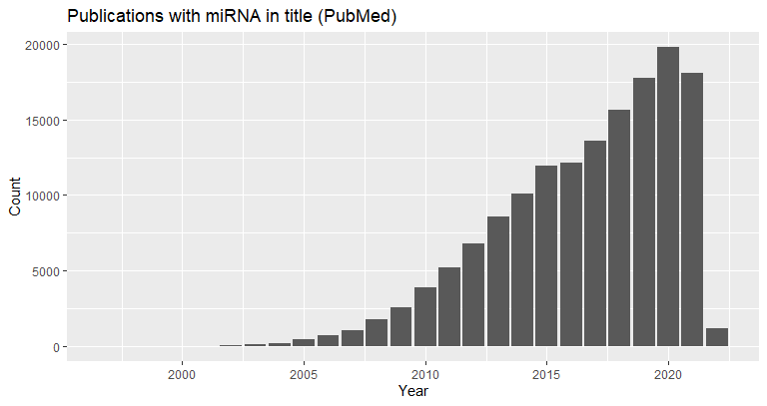
Evolution of miRNA study/importance
miRNAs fall into the class of RNAi-based therapeutics
1,120,000 Academic Google
134,677 in PubMed

Slide 6
MicroRNA databases
MicroRNA Networks

Slide 7

Database stuff
Information that is set up for easy access, management and updating
Relational database

Slide 8
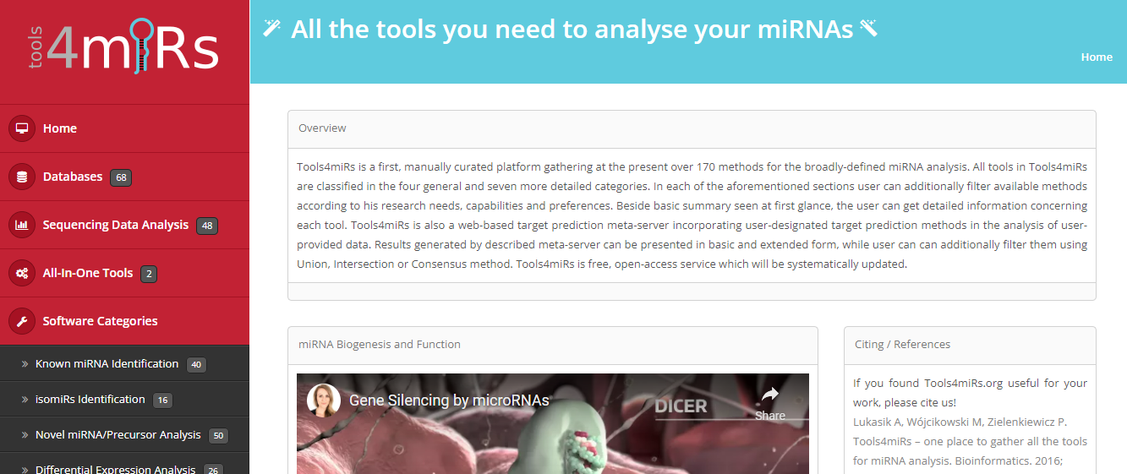
Tools4miRNA

Slide 9
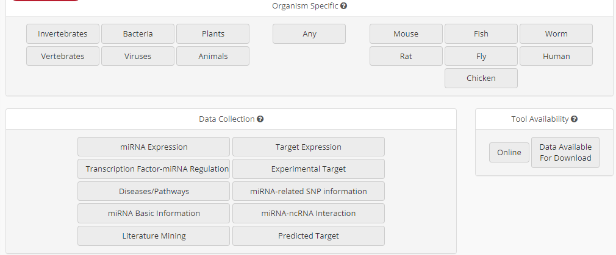
Tools4miRNA Search filters

Slide 10
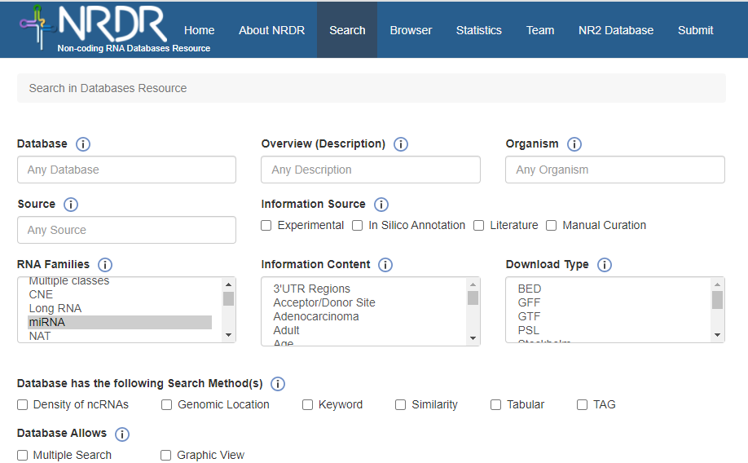
Noncoding RNA Database Resource

Slide 11
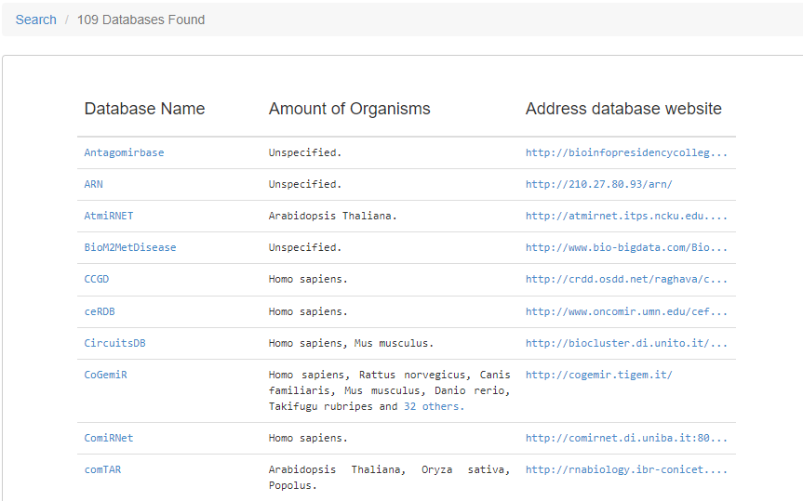
NRDR result for miRNA

Slide 12
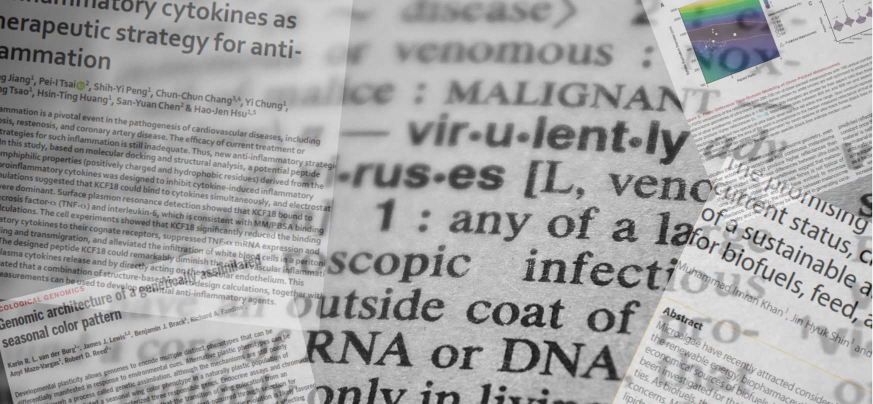

Paper miner

Slide 13


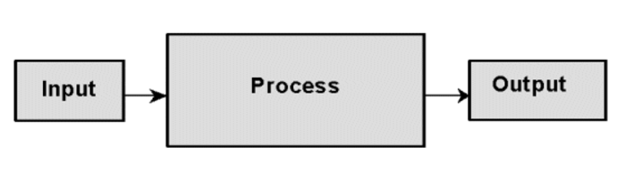
Year publication
Number of citations
Pubmed Query
List of “best” articles
Selection of the articles
("database"[Title] OR "repository"[Title] OR "dataset"[Title]) AND ("miRNA"[Title] OR "microRNA"[Title] OR "micro RNA"[Title])

Slide 14
Database | year | Cites | Organism | Website | down | avail | PubmedID | Content | information
miRBase | 2014 | 2368 | Miscellaneous | www.mirbase.org/ | Yes | Yes | 24275495 | General Information | miRNA/Target interactions
smiRNAdb | 2007 | 1817 | Miscellaneous | www.mirz.unibas.ch/cloningprofiles/ | No | No | 17604727 | Expression datasets | Expression profiles
microRNA.org | 2008 | 1270 | Miscellaneous | www.microrna.org/ | No | No | 18158296 | Predicted miRNA | Expression profiles miRNA/Target interactions Phylogeny
miRWalk | 2011 | 830 | NA | NA | NA | NA | 21605702 | Predicted miRNA | Target gene
miRBase | 2019 | 809 | Miscellaneous | www.mirbase.org | Yes | Yes | 30423142 | General Information | miRNA/Target interactions
miRTarBase | 2010 | 563 | Miscellaneous | mirtarbase.mbc.nctu.edu.tw/ | Yes | Yes | 21071411 | General Information | miRNA/Target interactions Phylogeny
miRTarBase | 2016 | 523 | Miscellaneous | mirtarbase.mbc.nctu.edu.tw | Yes | Yes | 26590260 | General Information | miRNA/Target interactions Phylogeny
HMDD | 2015 | 389 | Homo sapiens | 202.38.126.151/hmdd/mirna/md/ | No | No | 18923704 | Association to diseases | Disease
miRDB | 2020 | 374 | NA | NA | NA | NA | 31504780 | Expression datasets | Target gene
mirDIP | 2017 | 111 | Miscellaneous | ophid.utoronto.ca/mirDIP/ | Yes | Yes | 21364759 |  | miRNA/Target interactions
Rfam | 2021 | 49 | NA | NA | NA | NA | 33211869 |  | NA
miRNASNP | 2021 | 13 | NA | NA | NA | NA | 32990748 | Single nuclotide | Expression profiles miRNA/Target interactions SNPs
mirtronDB | 2019 | 5 | Plants | mirtrondb.cp.utfpr.edu.br/ | Yes | Yes | 30874795 |  | NA
CSCD2 | 2022 | 3 | NA | NA | NA | NA | 34551437 |  | NA
DIANAmiTED | 2022 | 0 | NA | NA | NA | NA | 34469540 |  | NA

Slide 15
Download data
Database | year | Cites | PubmedID | Content | Prediction Algorithm | API | API alternative
miRBase | 2014 | 2368 | 24275495 | General | NA | NA | NA
miRWalk | 2011 | 830 | 21605702 | Predicted miRNA | Yes | NA | NA
miRTarBase | 2010 | 563 | 21071411 | General | NA | NA | NA
miRDB | 2020 | 374 | 31504780 | Expression | Yes | NO | Yes
DIANAmiTED | 2022 | 0 | 34469540 | Expression | NA | NA | NA

Slide 16



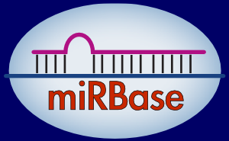


Characterization
Target mRNA
Expression Tissue
HMDD v3.2

Slide 17
Mature mirna
Mirna_id Precursor Start End
Mirna
Id Name Sequence Species_id
Species
Id Organism Name Genomic assembly

Slide 18

Tool to standardize gene names
+
Gene names

Slide 19

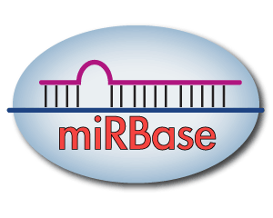
My own local database
+
=
19

Slide 20
Integration
Mature mirna
Mirna_id Precursor Start End
Target
Mature mirna Target gene Source Probability
Genes
Gene Disease
Mirna
Id Name Sequence Species_id

Slide 21
Queries
Select count( distinct (mirna_mature)) ,
count ( distinct (mrna) ),'sarcopenia‘
from binding
where mirna_mature like "hsa-%"
and mrna in (select gene
from gene_bank
where gene_bank.condition=' Sarcopenia')

Slide 22
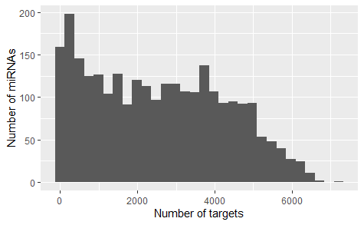

Slide 23
Networks

Slide 24
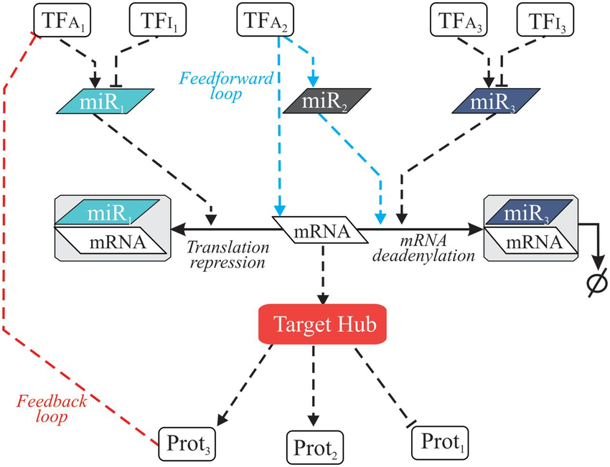
Regulatory Networks
Notes:
It is likely that miRNAs naturally build regulatory networks that control different cellular functions,

Slide 25
Regulatory Networks
Notes:
It is likely that miRNAs naturally build regulatory networks that control different cellular functions,
mathematical representation of a network and it describes the relationship between lines and points

Slide 26
Graph
Pictorial representation or a diagram that represents data or values in an organized manner.
Nodes
Edges

Slide 27
Graph
Pictorial representation or a diagram that represents data or values in an organized manner.
Nodes
Edges
miR-23a
MYOG
Inhibits
Associated
Sarco-penia

Slide 28
Definition of the network
Rules
Relationship
Biological entity 1
Biological entity 2

Slide 29
Queries
Network mirna bioinformatics

Slide 30
Pubmed_id | Year | Title | Cite_by
32398486 | 2022 | Identification of Serum miRNA Signature and Establishment of a Nomogram for Risk Stratification in Patients With Pancreatic Ductal Adenocarcinoma. | 8
31647101 | 2020 | miRTarBase 2020: updates to the experimentally validated microRNA-target interaction database. | 308
31369383 | 2021 | A Fast Linear Neighborhood Similarity-Based Network Link Inference Method to Predict MicroRNA-Disease Associations. | 33
29628290 | 2018 | The Immune Landscape of Cancer. | 1264
23634996 | 2013 | Genomic and epigenomic landscapes of adult de novo acute myeloid leukemia. | 1948
23000897 | 2012 | Comprehensive molecular portraits of human breast tumours. | 5010

Slide 31
What – How – For what

Slide 32
Queries
( ('Micro RNA'[Title])
OR (MicroRNA[Title]) OR (Mirna[Title]) OR (Disease[Title])
OR (Muscle[Title]) OR (Sarcopenia[Title]) )
AND ( (Computer[Title])
OR (Graph[Title]) OR (Model[Title]) OR (Network[Title])
OR (Networking[Title]) OR (Bioinformatic[Title]) OR (Simulation[Title]) )
AND ( (Association[Title])
OR (Development[Title])
OR (Discovery[Title]) OR (Prediction[Title]) OR (Functional[Title])
OR (Identification[Title]) OR (Inference[Title]) OR (Regulatory [Title])
OR (Signature[Title]) )

Slide 33
Queries
(((computer[Title]
OR Computational[Title])
AND
(representation OR model)
AND
(('Micro RNA'[Title])
OR (MicroRNA[Title]) OR (Mirna[Title]))
AND
(interaction OR identification))

Slide 34
Queries
((Network[Title]
OR Model[Title] OR Graph[Title] )
AND
(microRNA[Title] OR mirna[Title] ))
AND
(Bioinformatics[Title/Abstract]
OR Computational[Title/Abstract]
OR Computer[Title/Abstract] )

Slide 35
Queries
Network[Title]
AND
(mirna[Title] OR microRNA[Title])
AND
(bioinformatics OR computer[Title]
OR Computational[Title])

Slide 36
PubMed ID | Year | Title | Cites
32117922 | 2020 | A Computational Study of Potential miRNA-Disease Association Inference Based on Ensemble Learning and Kernel Ridge Regression. | 8
30186308 | 2018 | A Novel Computational Method for the Identification of Potential miRNA-Disease Association Based on Symmetric Non-negative Matrix Factorization and Kronecker Regularized Least Square. | 15
28339468 | 2017 | PBMDA: A novel and effective path-based computational model for miRNA-disease association prediction. | 139
31369383 | 2021 | A Fast Linear Neighborhood Similarity-Based Network Link Inference Method to Predict MicroRNA-Disease Associations. | 33
32484539 | 2020 | miRNet 2.0: network-based visual analytics for miRNA functional analysis and systems biology. | 87
31684860 | 2019 | MIENTURNET: an interactive web tool for microRNA-target enrichment and network-based analysis. | 45
30142158 | 2018 | MDHGI: Matrix Decomposition and Heterogeneous Graph Inference for miRNA-disease association prediction. | 112
29701758 | 2018 | BNPMDA: Bipartite Network Projection for MiRNA-Disease Association prediction. | 110
27795564 | 2016 | A network-biology perspective of microRNA function and dysfunction in cancer. | 270

Slide 37
Already reviewed literature
Authors | Year | Title | Cites
Xing Chen, [...], and Gui-Ying Yan | 2016 | HGIMDA: Heterogeneous graph inference for miRNA-disease association prediction. | 107
Sanghamitra Bandyopadhyay, [...], and Michael Q Zhang | 2010 | Development of the human cancer microRNA network | 100
Dong Wang, […], Qinghua Cui | 2010 | Inferring the human microRNA functional similarity and functional network based on microRNA-associated diseases | 234
Xing Chen, […], Li Huang2 | 2018 | MDHGI: Matrix Decomposition and Heterogeneous Graph Inference for miRNA-disease association prediction. | 114

Slide 38
Current approaches
Interaction miRNA-Disease
HMDD
Semantics
MeSH

Slide 39
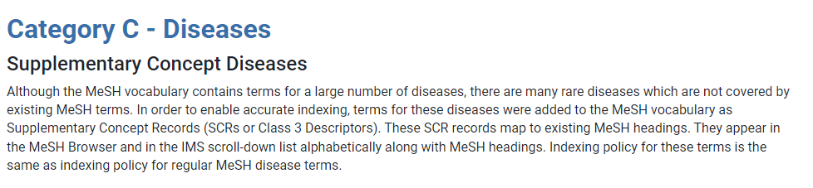

Slide 40
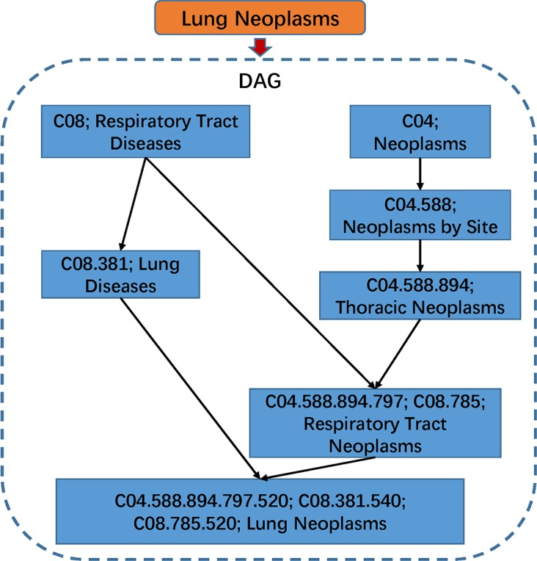

Slide 41
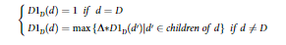
In DAG(D),the contribution of disease d to the semantic value of disease D was defined as:

Slide 42
Functional similarity

Slide 43
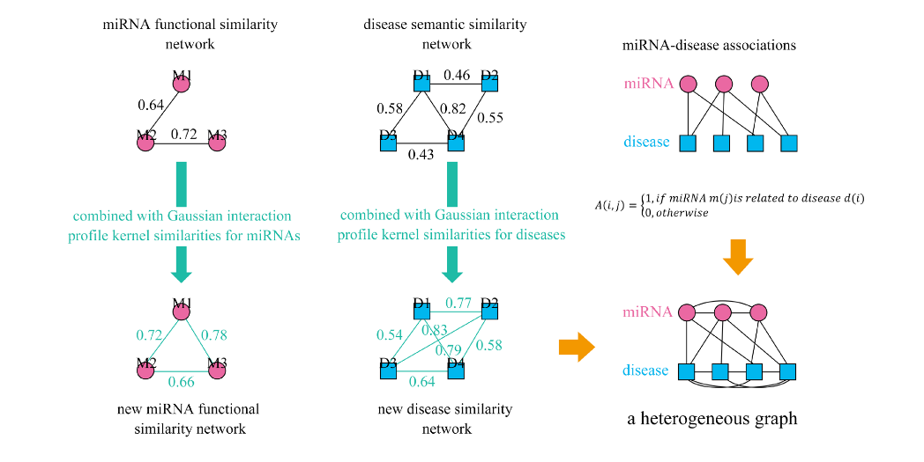

Slide 44


Slide 45
Acknowledgements
This presentation has emanated from research conducted with the financial support of Science Foundation Ireland under Grant number [18/CRT/6214 ]

Slide 46
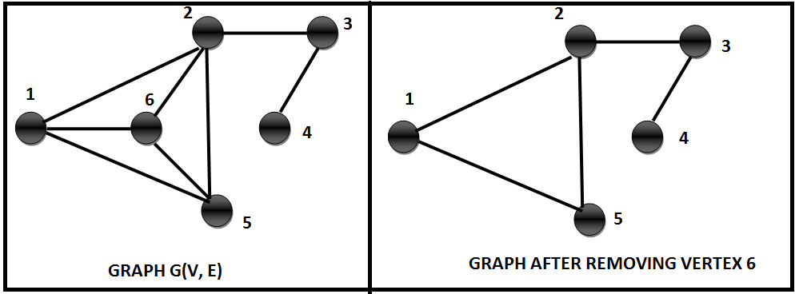

Graph operations
Similarity
Clusters
Centralities

Slide 47
Multi-objective optimization
Two objectives:
Having the most recent papers
With the most citations
Dominance:
An element that is better than other in all criteria
Pareto set
Set of elements that are not dominated by anyone else

Slide 48
How to select the data?
New
Relevant
Multiple Objective Optimization
PUBMD
Notes:
miRNA are defined as 18 to 25 nucleotide single stranded RNAs (ssRNAs), which are produced from hairpin shaped precursors. They are conserved small non-coding RNAs that play an important role in the regulation of gene expression and participate in a variety of biological processes miRNAs have been found to regulate almost all cellular functions including cell proliferation, growth, differentiation and apoptosis, And as we mention, have been implicated in controlling the fate and behavior of stem cells

Slide 49
How to select the data?
PUBMED
("database"[Title] OR "repository"[Title]
OR "dataset"[Title])
AND
("miRNA"[Title] OR "microRNA"[Title]
OR "micro RNA"[Title])
Notes:
miRNA are defined as 18 to 25 nucleotide single stranded RNAs (ssRNAs), which are produced from hairpin shaped precursors. They are conserved small non-coding RNAs that play an important role in the regulation of gene expression and participate in a variety of biological processes miRNAs have been found to regulate almost all cellular functions including cell proliferation, growth, differentiation and apoptosis, And as we mention, have been implicated in controlling the fate and behavior of stem cells

Slide 50
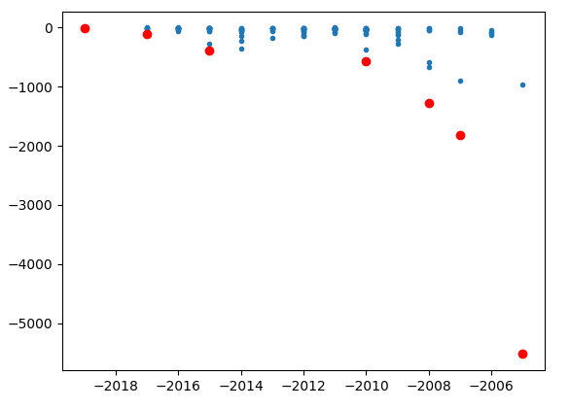
How to select the data?
Notes:
miRNA are defined as 18 to 25 nucleotide single stranded RNAs (ssRNAs), which are produced from hairpin shaped precursors. They are conserved small non-coding RNAs that play an important role in the regulation of gene expression and participate in a variety of biological processes miRNAs have been found to regulate almost all cellular functions including cell proliferation, growth, differentiation and apoptosis, And as we mention, have been implicated in controlling the fate and behavior of stem cells

Slide 52

miRNAs
Notes:
And we can implement the concept of distance and interconnection in order to interpret the impact of an miRNA.

Slide 53
Tissues
Notes:
And we can implement the concept of distance and interconnection in order to interpret the impact of an miRNA.

Slide 54
Conditions
Notes:
And we can implement the concept of distance and interconnection in order to interpret the impact of an miRNA.

Slide 55
Notes:
And we can implement the concept of distance and interconnection in order to interpret the impact of an miRNA.

Slide 56
Similarity
Cliks
Notes:
And we can implement the concept of distance and interconnection in order to interpret the impact of an miRNA.

Slide 57
3
2
Distance
1
Notes:
And we can implement the concept of distance and interconnection in order to interpret the impact of an miRNA.

Slide 59
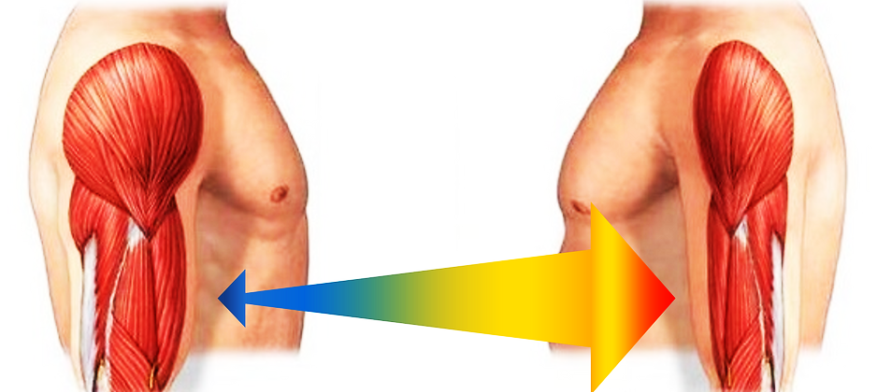
Notes:
One of the most striking effects of age is the involuntary loss of muscle mass, strength, and function, termed sarcopenia.

Slide 60
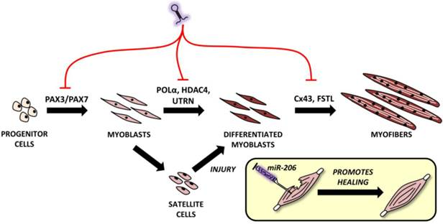
myomirs
Notes:
Muscles express their own set of muscle-enriched mirnas known as myomirs: mir1, 206, 208, 133, 486, 499.

Slide 61
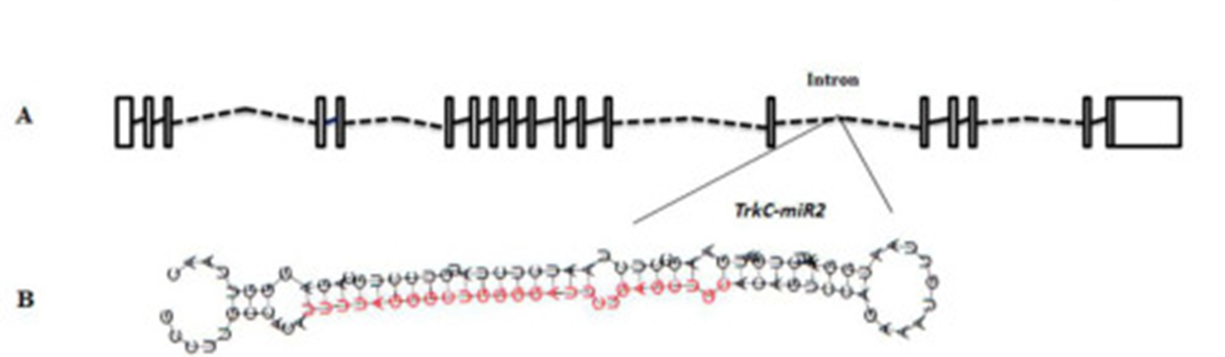
What is a miRNA
18-25 nt single stranded
conserved small non-coding RNAs
regulate almost all cellular functions
cell proliferation
Growth
differentiation
fate and behaviour of stem cells
Notes:
miRNA are defined as 18 to 25 nucleotide single stranded RNAs (ssRNAs), which are produced from hairpin shaped precursors. They are conserved small non-coding RNAs that play an important role in the regulation of gene expression and participate in a variety of biological processes miRNAs have been found to regulate almost all cellular functions including cell proliferation, growth, differentiation and apoptosis, And as we mention, have been implicated in controlling the fate and behavior of stem cells

Slide 62
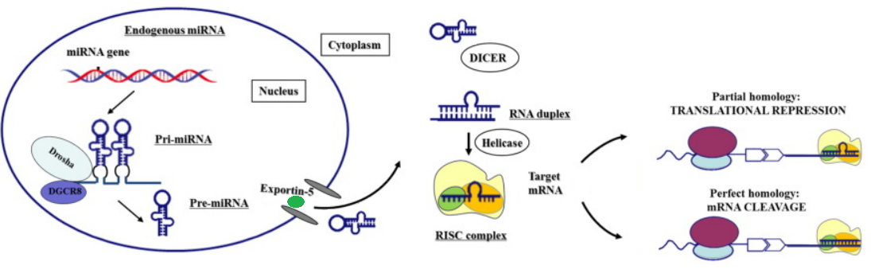
miRNA genesis
Notes:
Modified from https://www.thelancet.com/article/S2352-3964(16)30423-6/fulltext

Slide 63
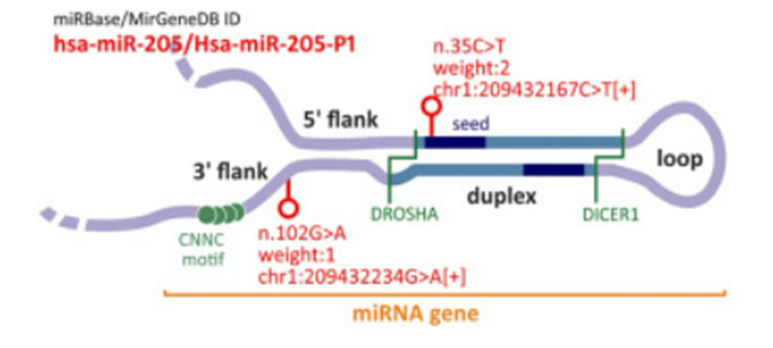
Notes:
https://www.sciencedirect.com/science/article/pii/S2666166721007292

Slide 64
Evolution of miRNA study
miRNAs fall into the class of RNAibased therapeutics
1,120,000 Academic Google
134,677 in PubMed

Slide 65
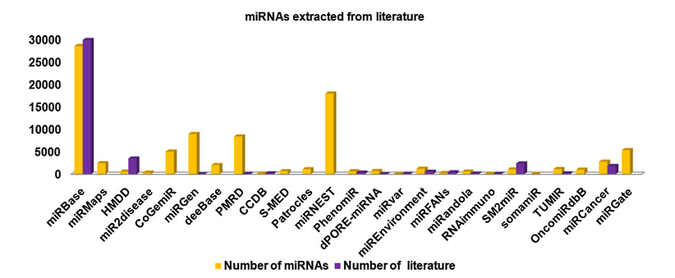
Number of miRNA in some DB

Slide 66
Garbage in, garbage out (GIGO)
Garbage data
Most amazing Data Science project ever
Garbage results

